Slide 1



SATHYABAMA
INSTITUTE OF SCIENCE AND TECHNOLOGY
Deemed to be University
Declared as category ‘A’ University by MHRD, Govt. of India
Jeppiaar Nagar, Rajiv Gandhi Salai, Chennai – 600 119, Tamil Nadu. India.
SUBJECT NAME:Data Structures
SUBJECT CODE: SCSA1203
UNIT : I

Slide 2
Unit-I
Introduction Data Structures - Need - classification - operations –Abstract data types (ADT) - Array - characteristics - types - storage representations. Array Order Reversal-Array Counting or Histogram-Finding the maximum Number in a Set, Recursion- Towers of Hanoi-Fibonacci series-Factorial.

Slide 3
Algorithm
Algorithm is finite set of logic or instructions, written in order for accomplishing the certain predefined task.
Each algorithm must have:
Specification: Description of the computational procedure.
Pre-conditions: The condition(s) on input.
Body of the Algorithm: A sequence of clear and unambiguous instructions.
Post-conditions: The condition(s) on output.

Slide 4
Characteristics of an Algorithm
Input: An algorithm must have 0 or well defined inputs.
Output: An algorithm must have 1 or well defined outputs, and should match with the desired output.
Finiteness: An algorithm must be terminated after the finite number of steps.
Effectiveness: An algorithm must have step-by-step directions which is independent of any programming code.
Definiteness: An algorithm must be unambiguous and clear.

Slide 5
Major categories of algorithms
Sort: Algorithm developed for sorting the items in certain order.
Search: Algorithm developed for searching the items inside a data structure.
Delete: Algorithm developed for deleting the existing element from the data structure.
Insert: Algorithm developed for inserting an item inside a data structure.
Update: Algorithm developed for updating the existing element inside a data structure.

Slide 6
performance of algorithm
Time complexity: It is a way of representing the amount of time needed by a program to run to the completion.
Space complexity: It is the amount of memory space required by an algorithm, during a course of its execution.

Slide 7
Data
Data means a value or set of values.
for example, student’s name and its id are the data about the student.

Slide 8
Structure
A structure is an arrangement of and relations between parts or elements.
It has a form or shape.

Slide 9
Data Structure
A data structure is an arrangement of data elements.
Data Structure can be defined as the group of data elements which provides an efficient way of storing and organizing data in the computer so that it can be used efficiently.
Examples of Data Structures are arrays, Linked List, Stack, Queue, etc
Data Structures are widely used in almost every aspect of Computer Science i.e. Operating System, Compiler Design, Artificial Intelligence, Graphics and many more.

Slide 10
Data Structure
Data Structure mainly specifies the following three things
Organization of Data
Accessing methods
Processing alternatives for information
Algorithm + Data Structure = Program

Slide 11
Advantages of Data Structures
Efficiency: Efficiency of a program depends upon the choice of data structures.
Reusability: Data structures are reusable, i.e. once we have implemented a particular data structure, we can use it at any other place.
Abstraction: Data structure is specified by the ADT which provides a level of abstraction

Slide 12
Classification of Data Structure
Data Structures are normally classified into two broad categories
1. Primitive Data Structure
2. Non-primitive data Structure

Slide 13
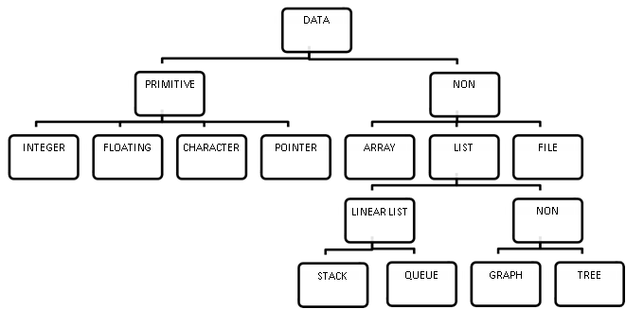
Classification of Data Structure

Slide 14
Classification of Data Structure
Primitive Data Structures
Simple data structure can be constructed with the help of primitive data structure.
A primitive data structure used to represent the standard data types of any one of the computer languages.
Variables, pointers, structures, unions, etc. are examples of primitive data structures.

Slide 15
Non Primitive Data Structures
Non Primitive Data Structures are classified as linear or non-linear.
Linear- Arrays, linked lists, queues and stacks.
Non-Linear- Trees and Graphs

Slide 16
Linear Data Structures
A data structure is called linear if all of its elements are arranged in the linear order.
In linear data structures, the elements are stored in non-hierarchical way where each element has the successors and predecessors except the first and last element.
Linear data structures can be constructed as a continuous arrangement of data elements in the memory.
It can be constructed by using array data type.

Slide 17
Types of Linear Data Structures
Arrays: An array is a collection of similar type of data items stored in consecutive memory location and is referred by common name; each data item is called an element of the array. The data type of the element may be any valid data type like char, int, float or double.
The elements of array share the same variable name but each one carries a different index number known as subscript. The array can be one dimensional, two dimensional or multidimensional.

Slide 18
Linked List
Linked list is a linear data structure which is used to maintain a list in the memory.
It can be seen as the collection of nodes stored at non-contiguous memory locations.
Each node of the list contains a pointer to its adjacent node.
It is a collection of data of same data type but the data items need not be stored in consecutive memory locations.

Slide 19
Stack
Stack is a linear list in which insertion and deletions are allowed only at one end, called top.
It is a Last-In-First-Out linear data structure.
A stack is an abstract data type (ADT), can be implemented in most of the programming languages.
It is named as stack because it behaves like a real-world stack, for example, piles of plates or deck of cards etc.

Slide 20
Queue
Queue is a linear list in which elements can be inserted only at one end called rear and deleted only at the other end called front.
It is a First-In-First-Out Linear data structure.
It is an abstract data structure, similar to stack.
Queue is opened at both end therefore it follows First-In-First-Out (FIFO) methodology for storing the data items.

Slide 21
Operations applied on Linear Data Structure
The following list of operations applied on linear data structures
1. Add an element
2. Delete an element
3. Traverse
4. Sort the list of elements
5. Search for a data element

Slide 22
Arrays
The number of data items chunked together into single unit is known as data structure.
Sequence of Similar Data Items referred to as an Array.
Definition:
An array is the most fundamental data structure from which other data structures may be built such as stack, queue, strings etc.
Designed to hold number of objects (items) of similar types.
An efficient data structure for storing and retrieval of objects.

Slide 23
Arrays
Array is the logical collection of values of same type.
For example:
List of courses in a semester
Matrix
Daily temperature over a period of time
List of students in a class

Slide 24
Syntax
datatype [] arrayName
arrayName = new dataType[size of the array]
datatype [] arrayName = new dataType[size of the array]
Example
int [] i;
i = new int[10];
int [] i = new int[10];

Slide 25
Initialization – Single Dimension Array
int [] x = new int[1];
int [] x = {10};
int [] x = { 10, 20 };
x
10
x
10
20

Slide 26
Characteristics
Array stores elements of same data type.
The elements of an array are stored in contiguous memory locations.
When data objects are stored in array, individual objects are selected by an index. By default an array index starts from 0 and ends with (n-1). Index is also referred as subscripts.
The size of the array is mentioned at the time of declaring array.
While declaring 2D array, number of columns should be specified whereas for number of rows there is no such rule.
Size of array can’t be changed at run time (depends on the programming language)

Slide 27
Storage Representation
An array is a set of homogeneous elements.
Every element is referred by an index.
Memory storage locations of the elements are not arranged as a rectangular array with rows and columns. Instead they are arranged in a linear sequence beginning with location 1,2,3 and so on.
The nature of storage depends on how the programming language stores the 2D array elements.
The elements are stored either column-by-column (column-major order) or row-by-row (row-major order).

Slide 28
Example – Row Major Order
Data (A):
1 2 3 4
5 6 7 8
9 10 11 12
Rows : 3
Columns : 4
Linear Arrangement of Array A
Row | 1 |  |  |  | 2 |  |  |  | 3
Index | (1,1) | (1,2) | (1,3) | (1,4) | (2,1) | (2,2) | (2,3) | (2,4) | (3,1) | (3,2) | (3,3) | (3,4)
Memory | 100 | 102 | 104 | 106 | 108 | 110 | 112 | 114 | 116 | 118 | 120 | 122
Data | 1 | 2 | 3 | 4 | 5 | 6 | 7 | 8 | 9 | 10 | 11 | 12

Slide 29
Access
Columns: N
Element at i^{th} row and j^{th} column is at the position
N * ( i – 1 ) + ( j – 1 )

Slide 30
Example – Column Major Order
Data (A):
1 2 3 4
5 6 7 8
9 10 11 12
Rows : 3
Columns : 4
Linear Arrangement of Array A
Column | 1 |  |  | 2 |  |  | 3 |  |  | 4
Index | (1,1) | (2,1) | (3,1) | (1,2) | (2,2) | (3,2) | (1,3) | (2,3) | (3,3) | (1,4) | (2,4) | (3,4)
Memory | 100 | 102 | 104 | 106 | 108 | 110 | 112 | 114 | 116 | 118 | 120 | 122
Data | 1 | 5 | 9 | 2 | 6 | 10 | 3 | 7 | 11 | 4 | 8 | 12

Slide 31
Row Major Order
Location (A [j,k] ) = Base Address of (A) + w [ (N * (j-1)) + (k-1) ]
Location (A [j, k] ): Location of j^{th} row and k^{th} column
Base (A) : Base Address of the Array A
w : Bytes required to represent single element of the Array A
N : Number of columns in the Array
j : Row position of the element
k : Column position of the element

Slide 32
Example
Linear Arrangement of Array A
Row | 1 |  |  |  | 2 |  |  |  | 3
Index | (1,1) | (1,2) | (1,3) | (1,4) | (2,1) | (2,2) | (2,3) | (2,4) | (3,1) | (3,2) | (3,3) | (3,4)
Memory | 100 | 102 | 104 | 106 | 108 | 110 | 112 | 114 | 116 | 118 | 120 | 122
Data | 1 | 2 | 3 | 4 | 5 | 6 | 7 | 8 | 9 | 10 | 11 | 12
Base (A) = 100
w = 2 Bytes (integer type)
N = 4
j = 3
k = 2
Location ( A [3, 2] ) = 100 + 2 [ (4 * (3-1) + (2-1) ]
= 118

Slide 33
Column Major Order
Location (A [j, k] ) = Base Address of (A) + w [ (M * (k-1)) + (j-1) ]
Location (A [j, k] ): Location of j^{th} row and k^{th} column
Base (A) : Base Address of the Array A
w : Bytes required to represent single element of the Array A
M : Number of rows in the Array
j : Row position of the element
k : Column position of the element

Slide 34
Example
Linear Arrangement of Array A
Column | 1 |  |  | 2 |  |  | 3 |  |  | 4
Index | (1,1) | (2,1) | (3,1) | (1,2) | (2,2) | (3,2) | (1,3) | (2,3) | (3,3) | (1,4) | (2,4) | (3,4)
Memory | 100 | 102 | 104 | 106 | 108 | 110 | 112 | 114 | 116 | 118 | 120 | 122
Data | 1 | 5 | 9 | 2 | 6 | 10 | 3 | 7 | 11 | 4 | 8 | 12
Base (A) = 100
w = 2 Bytes (integer type)
M = 3
j = 3
k = 2
Location ( A [3, 2] ) = 100 + 2 [ (3 * (2-1) + (3-1) ]
= 110

Slide 35
Array Types
Single Dimension Array
Multi Dimension Array
Double Dimension Array (or) Matrix
Three Dimension Arrays

Slide 36
Initialization – Double Dimension Array
int [][] x = new int[1][1];
Int [][] x = new int[4][3];
int [][] x = {10};
int [][] x = { {10, 20}, {30, 40} };
x
10
x
10
20
30
40

Slide 37
Three Dimensional Array
int [][][] A = new int[3][4][3];
(1,1,1) | (1,1,2) | (1,1,3)
(1,2,1) | (1,2,2) | (1,2,3)
(1,3,1) | (1,3,2) | (1,3,3)
(1,4,1) | (1,4,2) | (1,4,3)
(2,1,1) | (2,1,2) | (2,1,3)
(2,2,1) | (2,2,2) | (2,2,3)
(2,3,1) | (2,3,2) | (2,3,3)
(2,4,1) | (2,4,2) | (2,4,3)
(3,1,1) | (3,1,2) | (3,1,3)
(3,2,1) | (3,2,2) | (3,2,3)
(3,3,1) | (3,3,2) | (3,3,3)
(3,4,1) | (3,4,2) | (3,4,3)
1
2
3

Slide 38
Reversing an Array
Input: A = [1, 2, 3, 4, 5]
Output: A = [5, 4, 3, 2, 1]
Algorithm:
n = length of the Array (A)
for i = n – 1, j = 0, i >= 0, increment j by 1 and decrement i by
B[j] = A[i]
for i = 0 to n
A[i] = B[i]

Slide 39
Array Count
Initialize i as 0
Do following while i < n
// If this element is already processed then nothing to do
a) If arr[i] 0)
(i) arr[i] = arr[elementIndex];
// After storing arr[elementIndex], change it to store initial count of 'arr[i]'
(ii) arr[elementIndex] = -1;
d) else
// If this is NOT first occurrence of arr[i], then decrement its count.
(i) arr[elementIndex]--;
// And initialize arr[i] as 0 means the element 'i+1' is not seen so far
(ii) arr[i] = 0;
(iii) i++;
3)Now -arr[i] stores count of i+1.

Slide 40
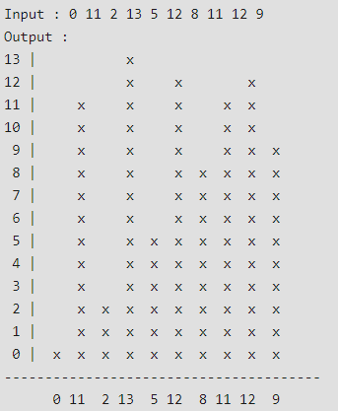
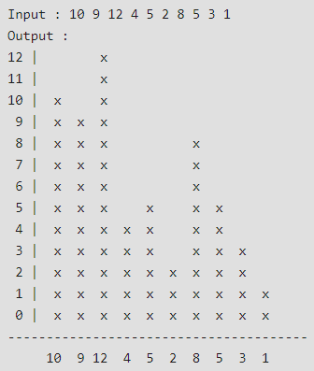
Histogram

Slide 41
Procedure
// print last line denoted by ----
for (int i = 0; i < n + 3; i++)
cout << "---";
cout << "\n";
cout << " ";
for (int i = 0; i < n; i++) {
cout.width(2); // width for a number
cout << right << arr[i] << " ";
}
}
int main()
{
int arr[10] = { 10, 9, 12, 4, 5, 2, 8, 5, 3, 1 };
int n = sizeof(arr) / sizeof(arr[0]);
printHistogram(arr, n);
return 0;
}
#include <bits/stdc++.h>
void printHistogram(int arr[], int n)
{
int maxEle = *max_element(arr, arr + n);
for (int i = maxEle; i >= 0; i--) {
cout.width(2);
cout << right << i << " | ";
for (int j = 0; j < n; j++) {
// if array of element is greater
// then array it print x
if (arr[j] >= i)
cout << " x ";
// else print blank spaces
else
cout << " ";
}
cout << "\n";
}

Slide 42
Int fibo(n) {
If (n==0) return 0;
If (n==1) return 1;
return fibo(n-1)+fibo(n-2);
}
n = 3
Int fibo(n) {
If (n==0) return 0;
If (n==1) return 1;
return fibo(n-1)+fibo(n-2);
}
Int fibo(n) {
If (n==0) return 0;
If (n==1) return 1;
return fibo(n-1)+fibo(n-2);
}
n = 2
n = 1

Slide 43
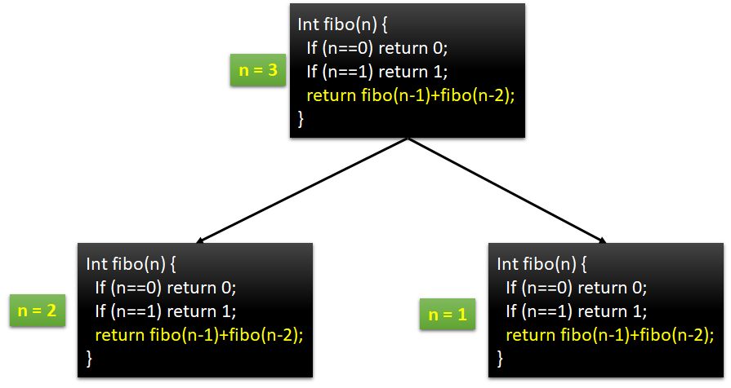
Int fibo(n) {
If (n==0) return 0;
If (n==1) return 1;
return fibo(n-1)+fibo(n-2);
}
Int fibo(n) {
If (n==0) return 0;
If (n==1) return 1;
return fibo(n-1)+fibo(n-2);
}
n = 1
n = 0

Slide 44
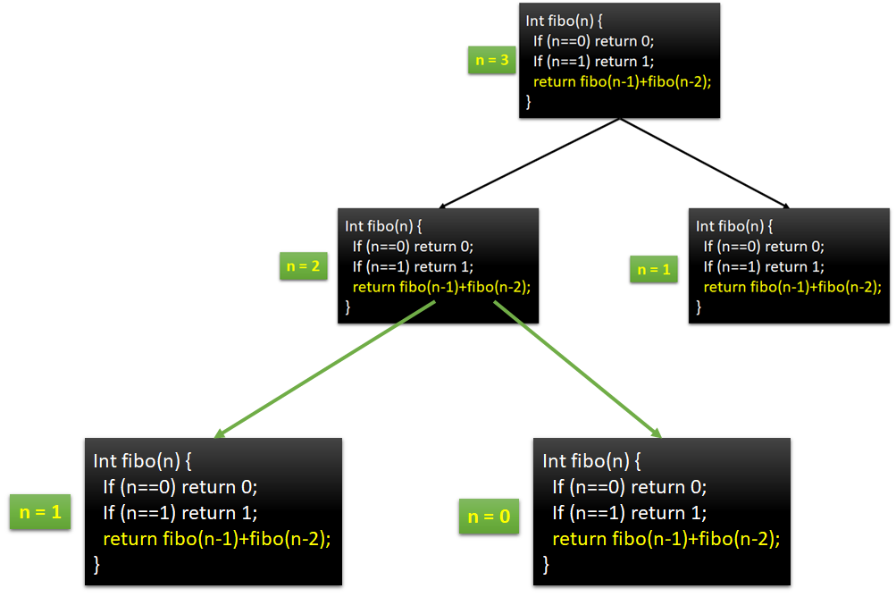
1 + 0 = 1
n = 1
n = 0
Int fibo(n) {
If (n==0) return 0;
If (n==1) return 1;
return fibo(n-1)+fibo(n-2);
}
Int fibo(n) {
If (n==0) return 0;
If (n==1) return 1;
return fibo(n-1)+fibo(n-2);
}

Slide 45
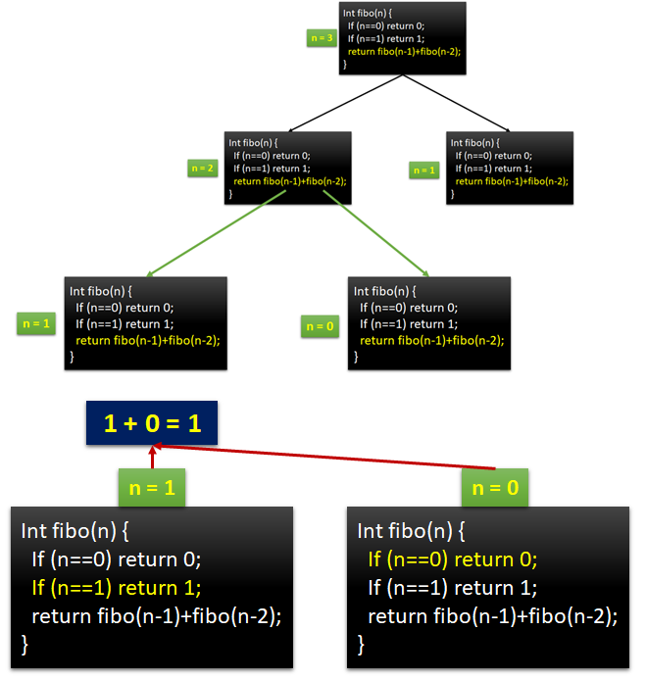
1 + 1 = 2
n = 1
Int fibo(n) {
If (n==0) return 0;
If (n==1) return 1;
return fibo(n-1)+fibo(n-2);
}

Slide 46
Towers of Hanoi
There are three towers
64 gold disks, with decreasing sizes, placed on the first tower
Need to move all of the disks from the first tower to the last tower
Larger disks can not be placed on top of smaller disks
The third tower can be used to temporarily hold disks

Slide 47
Tower of Hanoi
Source
Destination
Intermediate

Slide 48
Tower of Hanoi
Source
Destination
Intermediate

Slide 49
Tower of Hanoi
Source
Destination
Intermediate

Slide 50
Tower of Hanoi
Source
Destination
Intermediate

Slide 51
Tower of Hanoi
Source
Destination
Intermediate

Slide 52
Tower of Hanoi
Source
Destination
Intermediate

Slide 53
Tower of Hanoi
Source
Destination
Intermediate

Slide 54
Tower of Hanoi
Source
Destination
Intermediate

Slide 55
Recursive Procedure
def moveDisk(n, source, dest, inter): if n>=1: moveDisk(n-1, source, inter, dest) print("Moving Disk From:“,source,"To:",dest) moveDisk(n-1, inter, dest, source) moveDisk(3, "A", "B", "C")

Slide 56
Output
Moving Disk C From: A To: B
Moving Disk B From: A To: C
Moving Disk A From: B To: C
Moving Disk C From: A To: B
Moving Disk B From: C To: A
Moving Disk A From: C To: B
Moving Disk C From: A To: B

Slide 57
3, A, B, C
2, A, C, B
1, A, B, C
1, B, C, A
2, C, B, A
1, C, A, B
1, A, B, C
0, A, C, B
0, C, B, A
0, B, A, C
0, C, B, A
0, A, C, B
0, A, C, B
0, B, A, C
0, C, B, A

Slide 58
Tail Recursion
void print(int n)
{
if (n < 0)
return;
printf(“%d”, n);
print(n-1);
}

Slide 59
Operations on Data Structures
Traversing
Searching
Inserting
Deleting
Sorting
Merging

